Slide 1
Topic:- Agile Calculator Roadmap
Agile Life Cycle for Calculator Product (with TDD)
G-1 Group
Group Name | Slides
Jyotirmay Chowdhury(coordinator) - 30639 | 2-4
Nandhu -30400 | 5-7
Abhigyan Maji- 30382 | 8-10
Shikha - 31136 | 11-15
Gourab Das - 30392 | 16-18

Slide 2
1. Concept / Initiation Phase
• Goal: Build a basic calculator application.
• Initial Features: Add, Subtract, Multiply, Divide.
• Stakeholders: Product Owner, Developers, QA.

Slide 3
2. Product Backlog Creation
• Create user stories to define the product requirements.
• As a user, I want to add/subtract/multiply/divide numbers.
• As a user, I want to handle divide-by-zero errors gracefully.

Slide 4
3. Sprint Planning
• Select features/user stories for the upcoming sprint.
• Define the sprint goal (e.g., basic arithmetic operations).

Slide 5
4. Sprint Execution / Development (Using TDD)
• Write a failing test for each function.
• Implement minimum code to pass the test.
• Refactor if needed.
• Example:
def test_add():
assert add(2, 3) == 5
def add(a, b):
return a + b

Slide 6
5. Daily Scrum
• 15-minute stand-up meetings to discuss:
• - What was done yesterday?
• - Any blockers?
• - What is planned for today?

Slide 7
6. Sprint Review
• Demonstrate the working calculator functions.
• Collect feedback from stakeholders.
• Accept or reject the sprint deliverables.

Slide 8
7. Sprint Retrospective
• Discuss what went well, what didn’t.
• Plan improvements for the next sprint.

Slide 9
8. Next Sprint
• Add advanced features: square root, percentage, GUI support.

Slide 10
9. Release / Deploy
• If features are stable and tested:
• - Deploy for internal/external users.
• - Prepare release notes and documentation.

Slide 11
Agile Sprint Timeline
• Sprint 0: Setup environment, CI/CD, backlog items.
• Sprint 1: Basic functions (add, subtract, multiply, divide).
• Sprint 2: Power, square root, percentage; parameterized tests.
• Sprint 3: Input validation, error handling, integration tests.
• Sprint 4: UI components, frontend integration, usability tests.
• Sprint 5: Performance optimization, full-system testing.
• Release: User acceptance, final fixes, deployment.

Slide 12
Agile Flow Summary
• Idea ➞ Product Backlog ➞ Sprint Planning ➞ Develop (TDD)
• ➞ Daily Scrum ➞ Review ➞ Retrospective ➞ Next Sprint

Slide 13
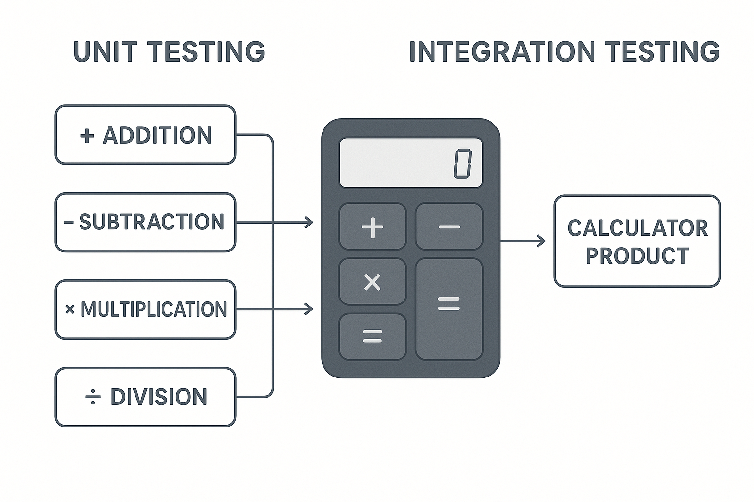
Test Cases for Calculator App (Agile Testing)
Unit, Integration, and Performance Testing Scenarios

Slide 14
Unit Testing – Scenarios
• 🔹 TC 1: Add two positive numbers
• ➤ Input: add(2, 3) → Expected: 5
• 🔹 TC 2: Divide by zero
• ➤ Input: divide(5, 0) → Expected: Error or Infinity

Slide 15
Integration Testing – Scenarios
TC 1: Full user flow (Input + Operation + Output)
• Input: Press 2 + 3 = → Expected: 5 displayed
TC 2: Chained operations
Input: 2 + 3 * 2 → Expected: 8 or 10 based on logic

Slide 16
Performance Testing – Scenarios
TC 1: High-speed input testing
100 operations in 10 seconds → Expected: No crash
TC 2: Heavy calculation
Input: 99999999 * 88888888 → Expected: Fast result, no freeze

Slide 17
Summary
• Unit Testing: Focuses on individual functions like add(), divide()
• Integration Testing: Checks flow between modules (UI to logic)
• Performance Testing: Verifies speed, stability under load

Slide 18
Conclusion
Unit testing ensures that each function of the calculator—such as add(), subtract(), multiply(), and divide()—works correctly in isolation. It helps identify and fix bugs early in individual components.
Integration testing validates how these individual functions interact when combined, such as evaluating full expressions like (2 + 3) × 5. It ensures all components work together as expected.
Together, unit and integration testing provide strong quality assurance for the calculator product by catching both functional and interaction issues before release

